Slide 1
RNA-Seq Data Analysis 3
Lauren Vanderlinden
BIOS 6660
Spring 2019

Slide 2
Overview From Last Time
Multiple Testing Issue in ‘Omics Analyses
How to Visualize Results
Enrichment Analyses
Transformations
Quick Note on Yampa Calling Programs:
export PATH=/usr/local/bin/samtools-1.3:$PATH
export PATH=/usr/local/bin/bowtie2:$PATH

Slide 3
Network Analyses
Data driven network analyses
Nodes are genes
Edges are the relationship between the genes
Application is for when you want to know what genes are working together in your system
Common Models:
K-means clustering
Hierarchical clustering
WGCNA

Slide 4
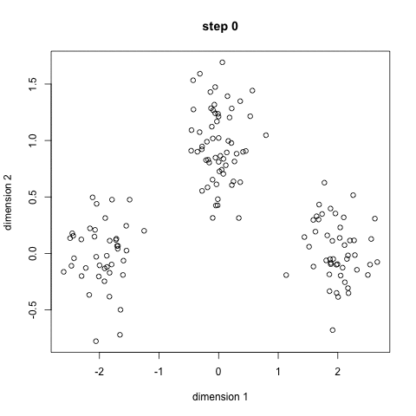
K-means Clustering
First define how many groups you have
This is NOT ideal
Look at PC plots to get an idea
Randomly initialize the groups center points
Compute the distances between each point and each group center
A node becomes a member of a group based on smallest distance
Re-compute cluster center by taking group means
Iterative process till group centers don’t change much
https://towardsdatascience.com/the-5-clustering-algorithms-data-scientists-need-to-know-a36d136ef68

Slide 5
WGCNA: Weighted Gene Co-expression Network Analysis
Popular method, well documented and very easy to use in R
Optimized for microarrays
This was my first time working in R!
Original Paper:
Bin Zhang and Steve Horvath (2005) "A General Framework for Weighted Gene Co-Expression Network Analysis", Statistical Applications in Genetics and Molecular Biology: Vol. 4: No. 1, Article 17 PMID: 16646834
http://dibernardo.tigem.it/files/papers/2008/zhangbin-statappsgeneticsmolbio.pdf
WGCNA links:
https://labs.genetics.ucla.edu/horvath/CoexpressionNetwork/Rpackages/WGCNA/Tutorials/
https://labs.genetics.ucla.edu/horvath/CoexpressionNetwork/OverviewWGCNA.pdf

Slide 6
WGCNA: More than Correlation
Simple correlation does not give connectivity
How are we measuring co-expression?
Scale-Free Network
Most biological networks have been defined as scale-free
System is robust to failure at any 1 gene
How do we get a robust measurement of connectivity to define modules?
Topological Overlap Measure
Includes a measure of how many “friends” two genes have in common
Protects against spurious correlations among genes

Slide 7
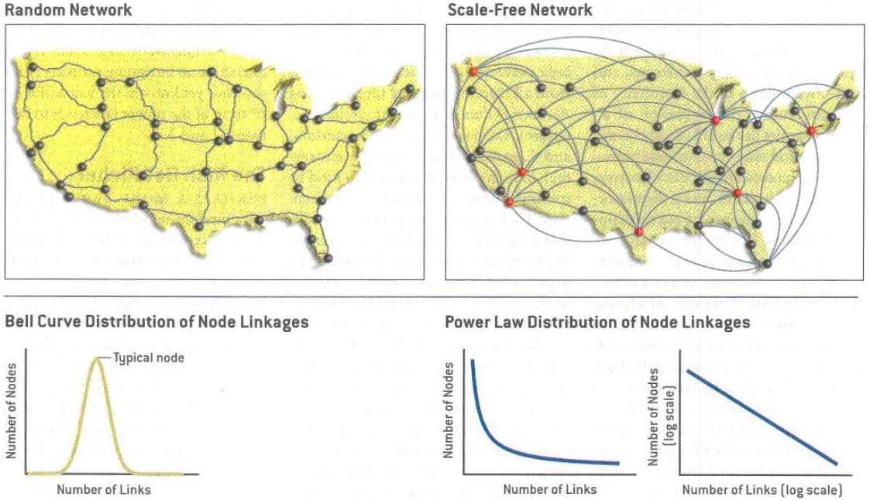
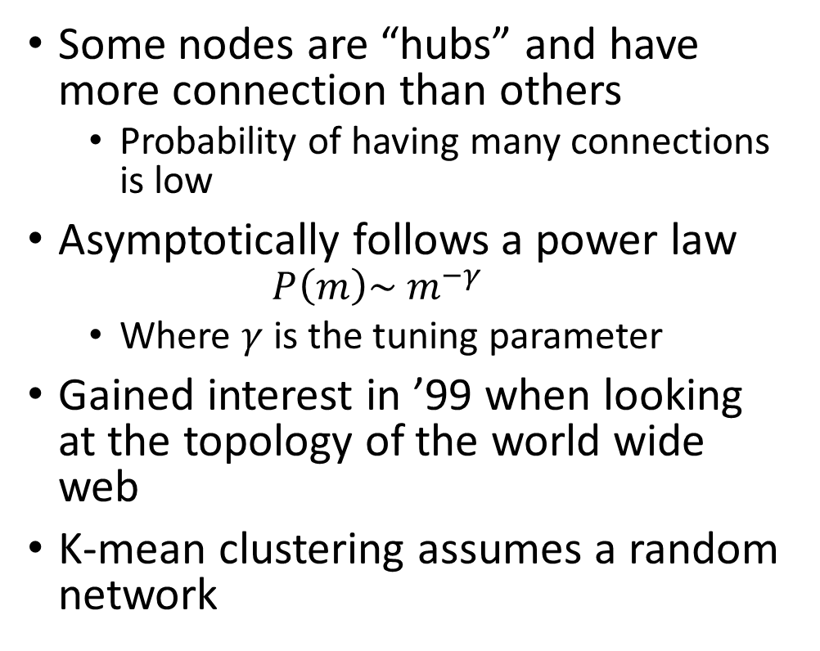
Scale-Free Networks
Some nodes are “hubs” and have more connection than others
Probability of having many connections is low
Asymptotically follows a power law
$$P\left(m\right)\sim m^{−γ}$$
Where $γ$ is the tuning parameter
Gained interest in ’99 when looking at the topology of the world wide web
K-mean clustering assumes a random network
Barabási, AL. Bonabeau, E. 2003. Scale-Free Networks. Scientific American 288 (5): 50–9.

Slide 8
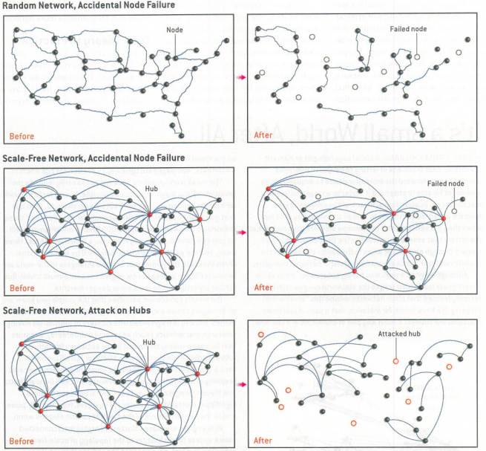
Barabási, AL. Bonabeau, E. 2003. Scale-Free Networks. Scientific American 288 (5): 50–9.

Slide 9
WGCNA Flow Chart
Step 1: Correlation Matrix
Step 2: Adjacency Matrix
Step 3: Topological Overlap Matrix
Step 4:
Tree Cutting
Step 5: Summarize & Characterize Modules

Slide 10

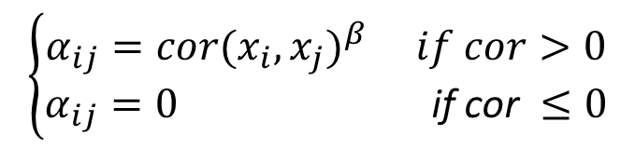
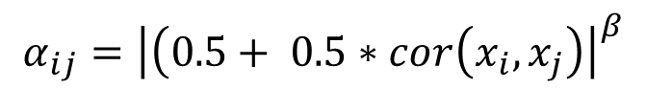
Constructing an Adjacency Matrix
Step 1: Correlation Matrix
Step 2: Adjacency Matrix
Correlate your genes
corType options in package: “pearson” (default), “bicor” (non-parametric option)
Biweight midcorrelation (bicor) is median based (rather than mean based)
Determine your network type
networkType options in package: “unsigned” (default), “signed”, or “signed hybrid”
Signed networks allows you to create module with only positively associated genes
Choose a soft-thresholding power (β)
Choose a beta so you have a scale-free network
adjacency()
$$α_{ij}={\left|cor(x_{i}, x_{j})\right|}^{β}$$
Unsigned Network
$$α_{ij}={\left|\left(0.5+ 0.5∗cor\left(x_{i}, x_{j}\right)\right.\right|}^{β}$$
Signed Network
$$\left\{\begin{aligned}α_{ij}=cor{(x_{i}, x_{j})}^{β} if cor>0 \\ α_{ij}=0 \text{if} \text{cor} ≤0\end{aligned}\right.$$
Signed Hybrid Network

Slide 11
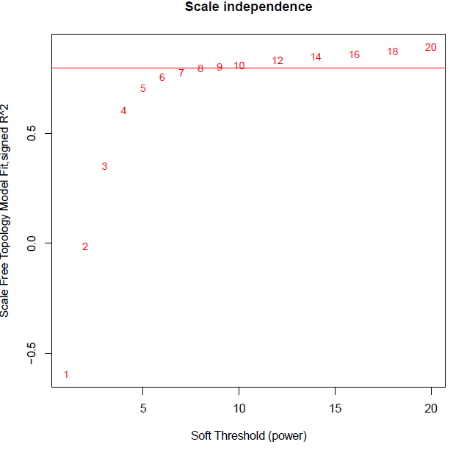
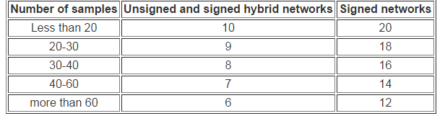
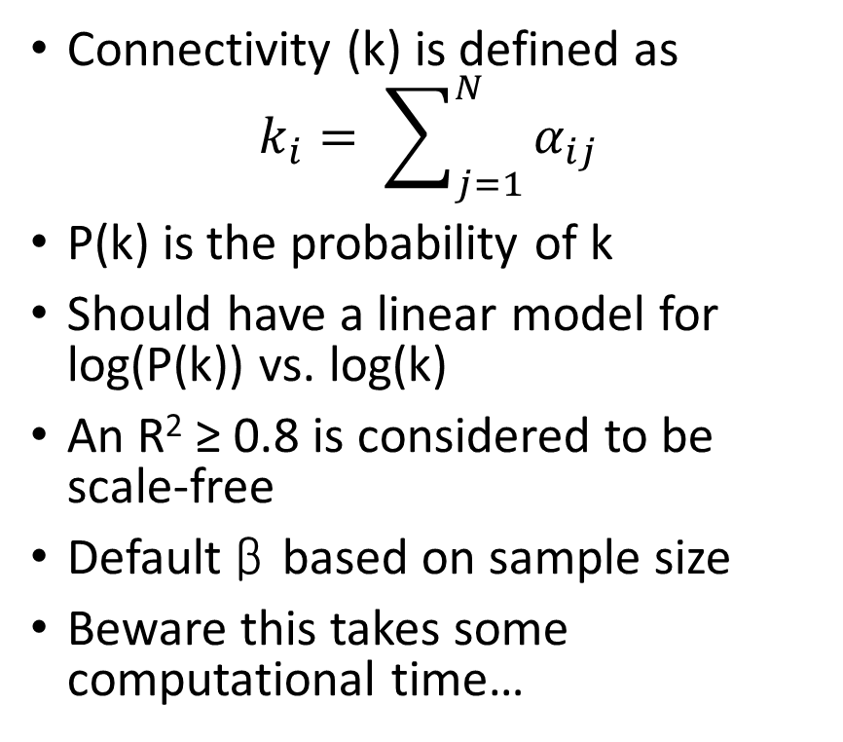
Choosing a β Parameter
Connectivity (k) is defined as
$$k_{i}= \sum_{j=1}^{N}{α_{ij}}$$
P(k) is the probability of k
Should have a linear model for log(P(k)) vs. log(k)
An R² ≥ 0.8 is considered to be scale-free
Default β based on sample size
Beware this takes some computational time…
Notes:
Absolute minimum is 15 samples, but they don’t recommend less than 20.

Slide 12
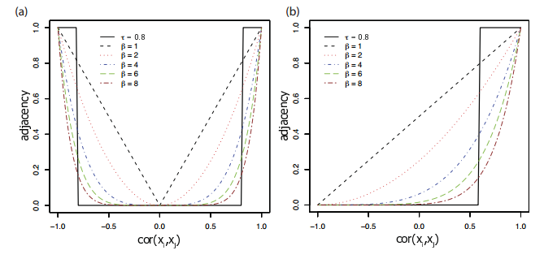
Power Adjacency vs Step Function
Unsigned Network Signed Network
https://labs.genetics.ucla.edu/horvath/CoexpressionNetwork/WORKSHOP/2012/Talk1OverviewWGCNAHorvath.pdf

Slide 13
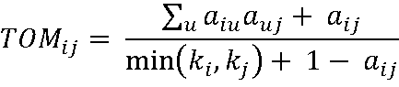
Topological Overlap Matrix (TOM)
Step 3: Topological Overlap Matrix
Transform adjacency matrix to topological overlap matrix (TOM)
k is connectivity and a is adjacency matrix
Includes the direct relationship between 2 transcripts (i, j)
Also includes their indirect interactions by comparing their relationships with all other transcripts in network
TOM close to 1 for two genes signifies high connectivity and co-expression
Can technically be considered a type of adjacency matrix
TOMsimilarity()

Slide 14
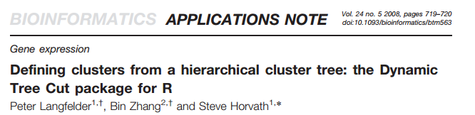
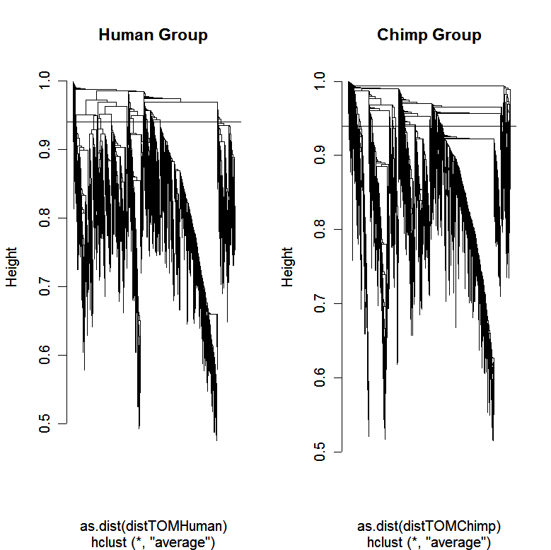
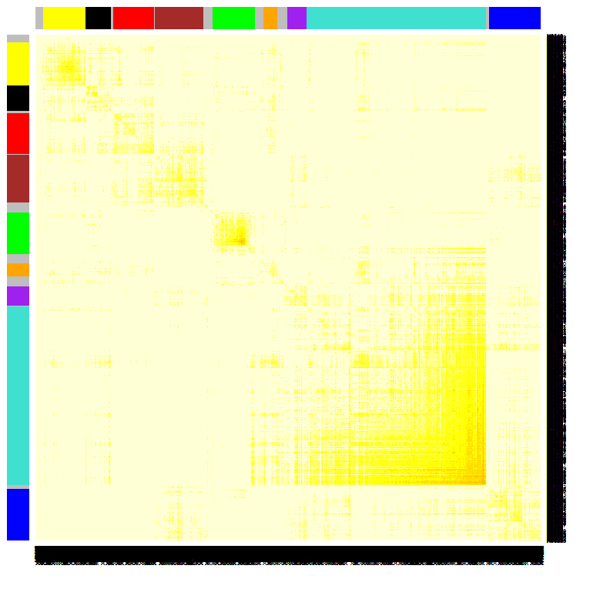
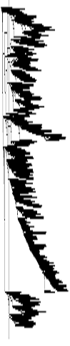
Defining Modules
Step 4: Tree Cutting
Perform hierarchical clustering with the topological overlap dissimilarity (1 – TOM) measure
Define modules as branches
2 types of branch cutting methods:
Static
Constant cut height
cutreeStatic()
Dynamic Hybrid
Not all defined branches are at a specific cut height
Combines static and partition around medoids (PAM)clustering
cutreeDynamic()
https://labs.genetics.ucla.edu/horvath/CoexpressionNetwork/WORKSHOP/2012/Talk1OverviewWGCNAHorvath.pdf

Slide 15
Tree Cutting Example
https://labs.genetics.ucla.edu/horvath/CoexpressionNetwork/WORKSHOP/2012/Talk1OverviewWGCNAHorvath.pdf

Slide 16
Tree Cutting Example
https://labs.genetics.ucla.edu/horvath/CoexpressionNetwork/WORKSHOP/2012/Talk1OverviewWGCNAHorvath.pdf

Slide 17
Tree Cutting Example
https://labs.genetics.ucla.edu/horvath/CoexpressionNetwork/WORKSHOP/2012/Talk1OverviewWGCNAHorvath.pdf

Slide 18
Tree Cutting Example
https://labs.genetics.ucla.edu/horvath/CoexpressionNetwork/WORKSHOP/2012/Talk1OverviewWGCNAHorvath.pdf

Slide 19
Tree Cutting Example
https://labs.genetics.ucla.edu/horvath/CoexpressionNetwork/WORKSHOP/2012/Talk1OverviewWGCNAHorvath.pdf

Slide 20
Settings for Defining Modules blockwiseModules()
mergeCutHeight (default = 0.15)
Static cut height to define modules
minModuleSize (default = 20)
Minimum size of a module you will accept, we used 5 alcohol related traits very complex and we are expecting smaller modules
If you are doing enrichment analysis you want a minimum of 20 genes
deepSplit (default = 2)
Integer value between 0 (least sensitive) and 4 (most sensitive) for a simplified control on how the module detection should be module splitting
We used 4 because we wanted smaller modules
pamRespectsDendro (default = TRUE)
Only use if using dynamic cut
where PAM respects the dendrogram and it won’t group objects into clusters unless they are from the same branch

Slide 21
Example Summary Results Whole Brain Network
Number of Probesets Placed Into Modules | 28,867
Number of Modules Identified | 499
Minimum Module Size | 5
Maximum Module Size | 2,881
Median Module Size | 9
Notes:
Not surprising the # probe sets placed into modules is highest in whole brain. We filtered on DABG on whole brain and were able to apply a mask….

Slide 22
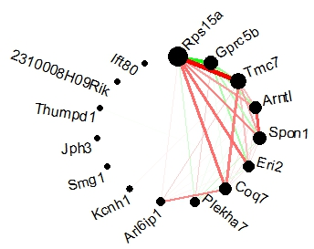
Summarizing Modules
Step 5: Summarize & Characterize Modules
HUB gene
Most connected gene in your module
Example: for hotpink3 hub gene is Rps15a
Eigengene
1st principal component of module
Check to see how much variance the eigengene explains
Hotpink3 module
Notes:
Rps15a = ribosomal protein S15A
The minimum % variance explained by candidate eigengene in whole brain = 91%

Slide 23
Characterization of Modules
Statistical Analysis of eigengene with physiological or behavioral trait
Gene Ontology and Pathway Enrichment
Cell-type specific expression
Source of expression control
Transcription factors
microRNA
Common eQTL
Module eigengene QTL (E-QTL)

Slide 24
Other Useful WGCNA functions
Function | What it does
chooseTopHubInEachModule() | identifies the hub gene in each module
moduleEigengenes() | calculates the module's eigengenes
propVarExplained() | calculates the proportion of variance explained by eigengenes
exportNetworkToCytoscape() | exports a network in edge and node list files in a format suitable for importing to Cytoscape
plotNetworkHeatmap() | network heatmap plot
plotDendroAndColors() | dendrogram plot with color annotation of objects
plotMEpairs() | pairwise scatter plots of eigengenes
circlePlot()* | visualize connectivity within a module
GOenrichmentAnalysis() | calculation of GO enrichment (experimental)
networkScreening() | identifies genes related to a trait by taking into account both the network and gene-centric info (experimental)

Slide 25
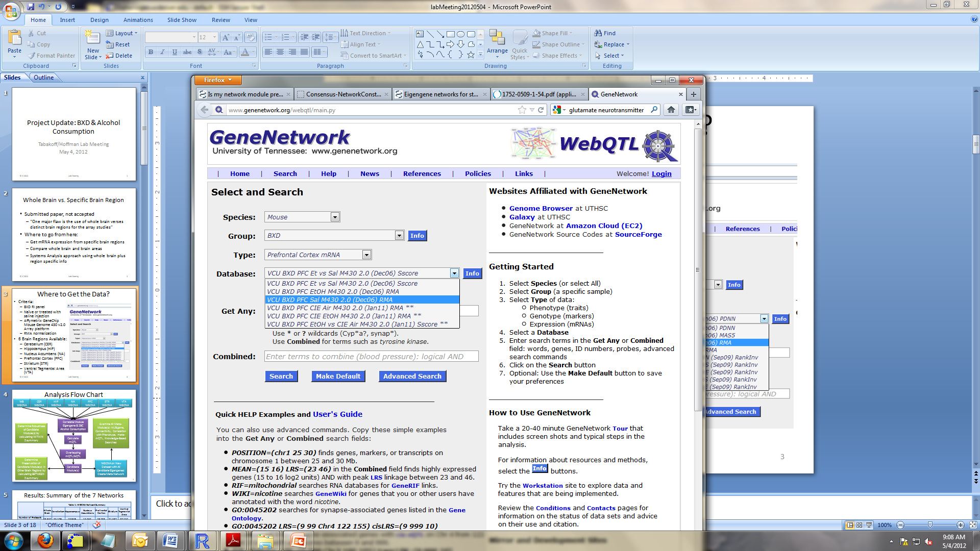
Comparing Networks
Example: Whole Brain vs Brain Region
Treatment vs control network
6 brain regions:
Cerebellum (CER)
Hippocampus (HIP)
Nucleus Accumbens (NA)
Prefrontal Cortex (PFC)
Striatum (STR)
Ventral Tegmental Area (VTA)
Created a network for each area using same probesets and same parameters as whole brain
Need to have same nodes (i.e. genes) going into network

Slide 26
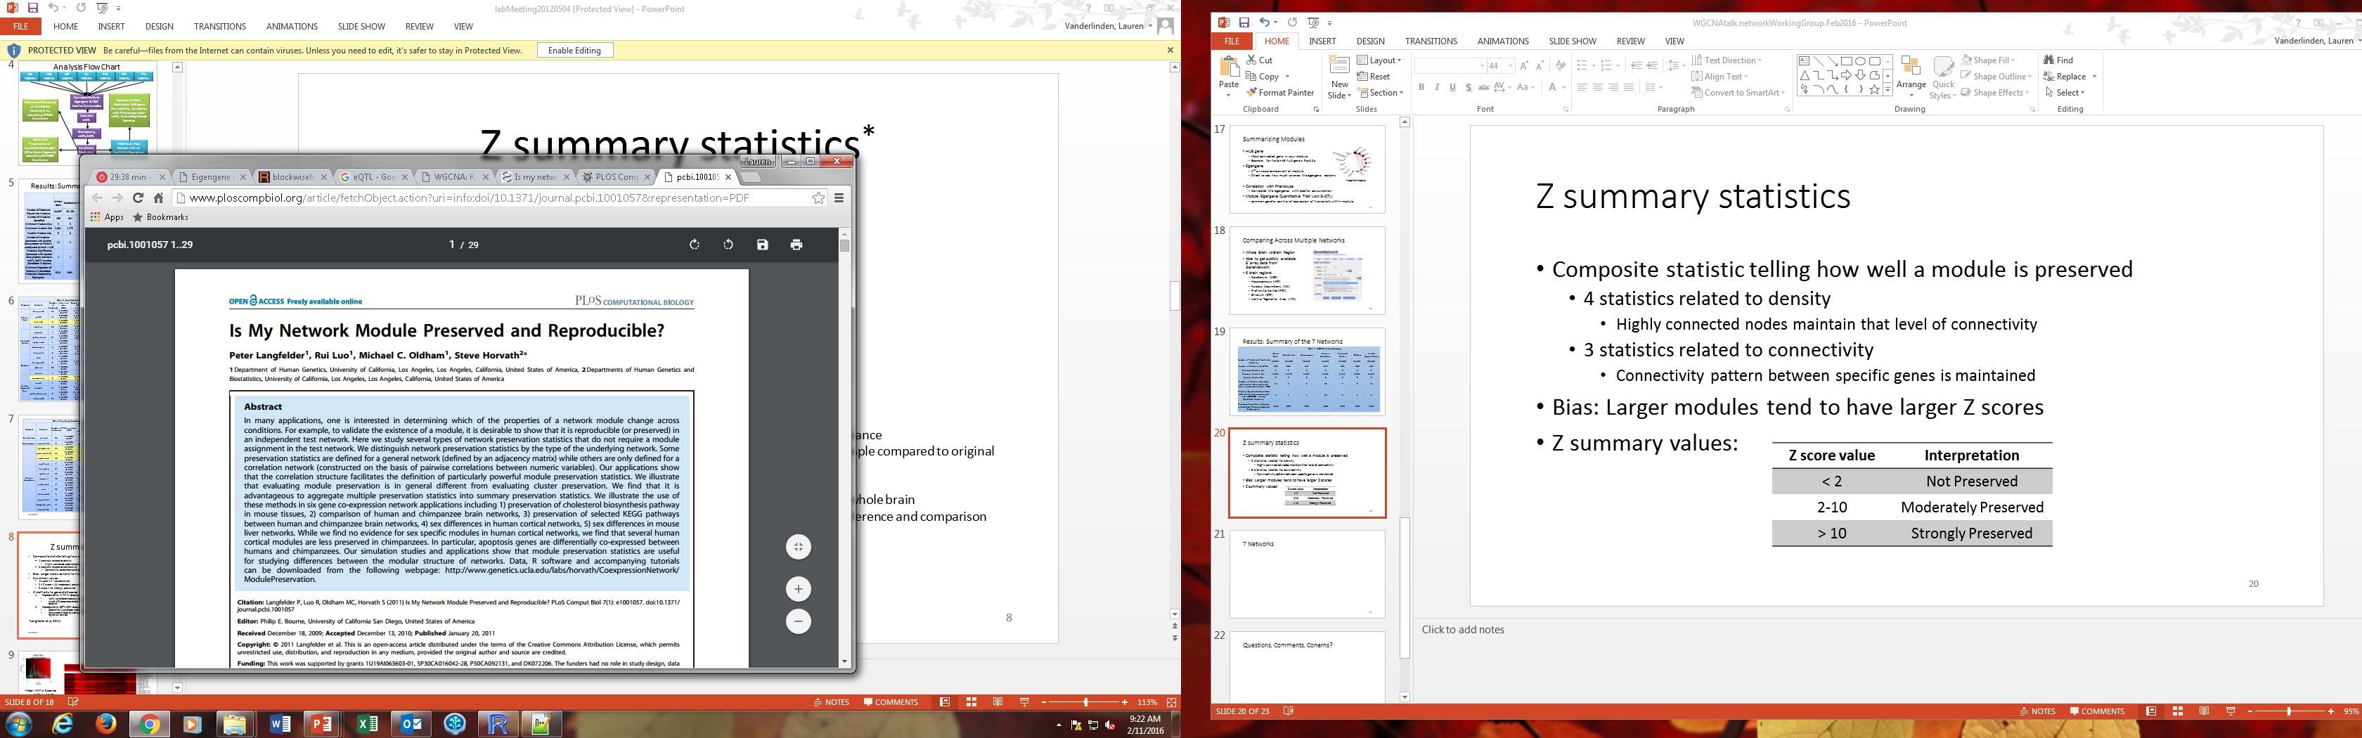
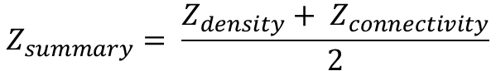
Z summary statistics
Composite statistic telling how well a module is preserved
4 statistics related to density
Highly connected nodes maintain that level of connectivity
3 statistics related to connectivity
Connectivity pattern between specific genes is maintained
Bias: Larger modules tend to have larger Z summary scores
modulePreservation()
$$Z_{density}=median(Z_{meanCor}, Z_{meanAdj}, Z_{propVarExpl}, Z_{meanKME})$$
$$Z_{connectivity}=median(Z_{cor.kIM}, Z_{cor.kME}, Z_{cor.cor})$$
$$Z_{summary}= \frac{Z_{density}+ Z_{connectivity}}{2}$$
Z summary | Interpretation
< 2 | Not Preserved
2-10 | Moderately Preserved
> 10 | Strongly Preserved

Slide 27
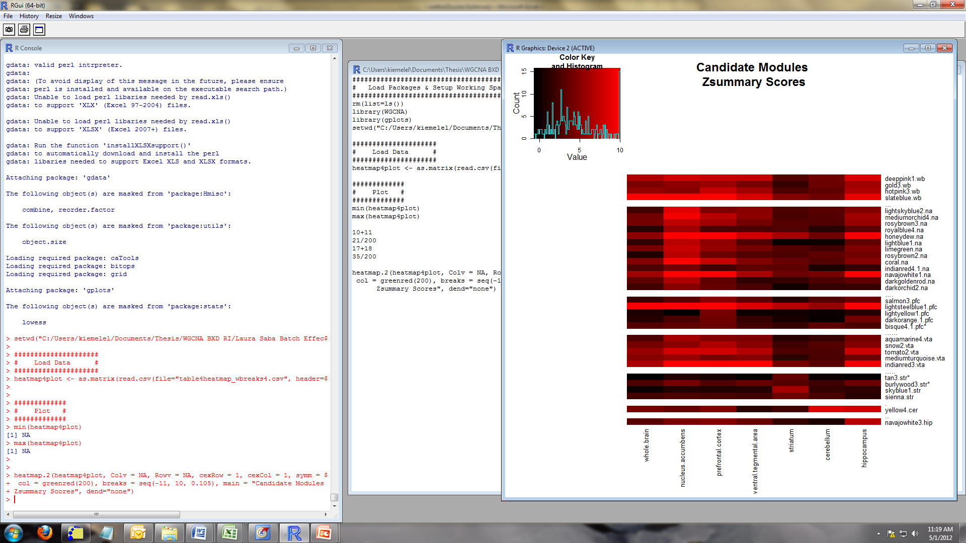
Methods to Generate Z summary Scores
Reproducibility WITHIN dataset
Verify candidate modules were of high quality and not generated by chance
Used 100 bootstrap samples, calculated Z summary for each bootstrap sample compared to original dataset
Reproducibility BETWEEN datasets
Determine if candidate modules are preserved in other brain regions/whole brain
Calculated Z summary by setting the dataset module originated from as reference and comparison region as test set
Note: you need to have same gene identifiers!
Mean Within Z scores range: 3.05 to 16.15
Only 3 modules have lower 95% CI bound < 2 (noted with *)
Between Z scores range: -0.67 to 17.05

Slide 28
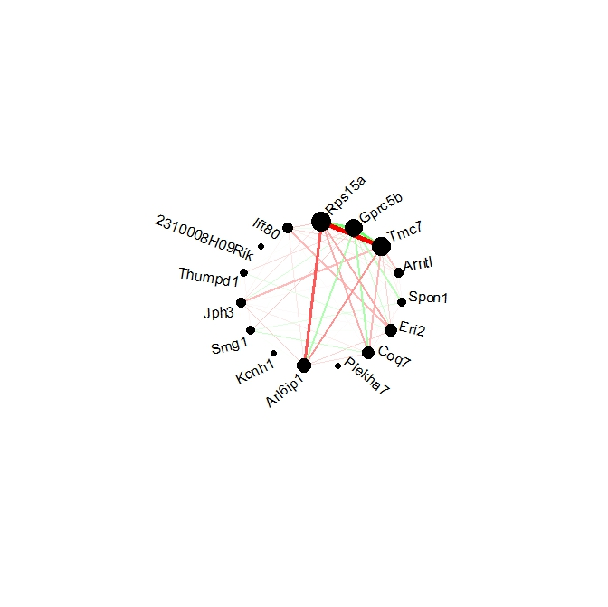
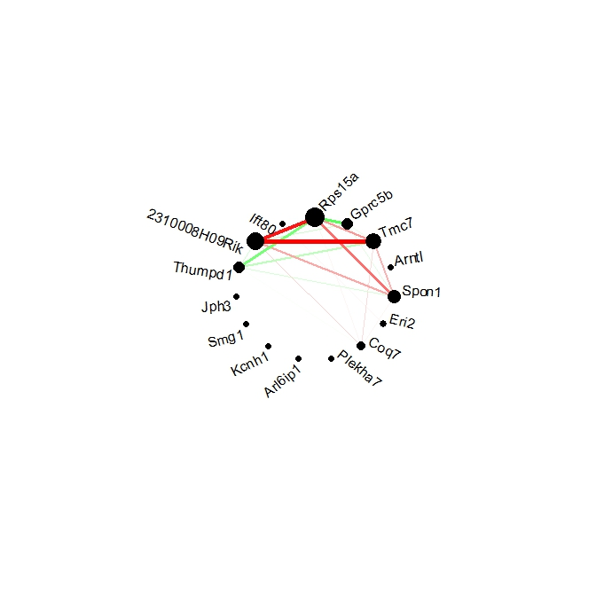
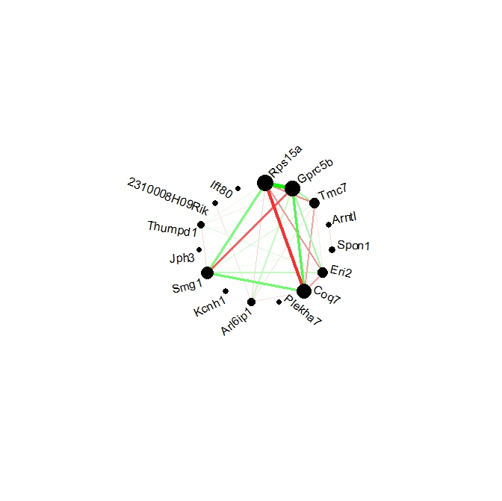
Hotpink3 from Whole Brain
Prefrontal Cortex
Striatum
Ventral Tegmental Area
Whole Brain

Slide 29
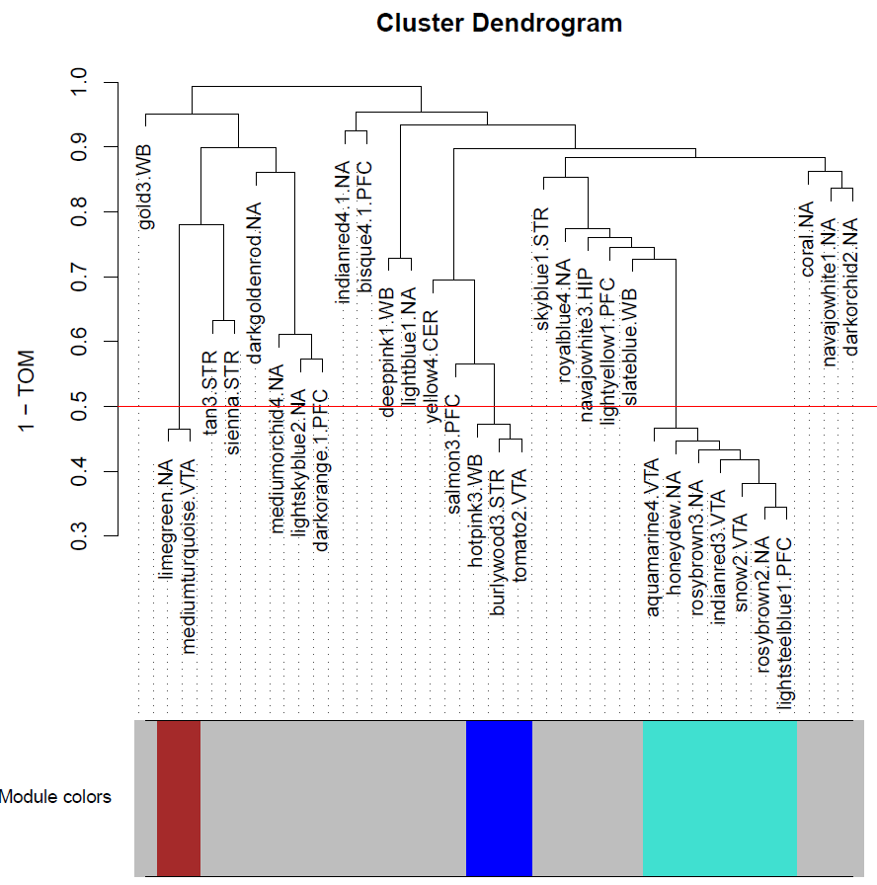
Eigengene Network
Notes:
Call these meta-modules

Slide 30
Modules Can Be Useful To…
Add biological context to unannotated or under annotated genes
Especially useful in organisms with little annotation (e.g. rats)
Explaining biomarkers
Make sense of biomarker given the other genes within module
How do module structure changes in different environments
Treatment
Tissue
Exposure
Finding target genes for pharmaceutical therapies

Slide 31
Pro and Con list for WGCNA
PRO’s:
Easy to use and understand
Peter Langfelder normally answers all questions in online forums directly.
Robust network
Scale-free
Indirect & Direct Interactions
Accepted by community
Most common form for network analyses I’ve seen for gene expression data (both microarray and sequencing)
CON’s:
Missing non-linear relationships
How do we choose which genes to include in the module?
I find the tree cutting the most difficult evaluate
Not easy to perform differential networks
How are my edges changing given a specific circumstance?
Are these modules truly clustered together functionally?

Slide 32
Something to Consider: Functional Results or Driven by Confounder
Some modules have genes physically in close proximity to one another and have extremely strong cis-QTL’s
Partial correlation adjusting for allele in the cis-QTL
Our candidate modules stayed highly correlated
Confounding issue: many genes functionally related are also physically located near each other

Slide 33
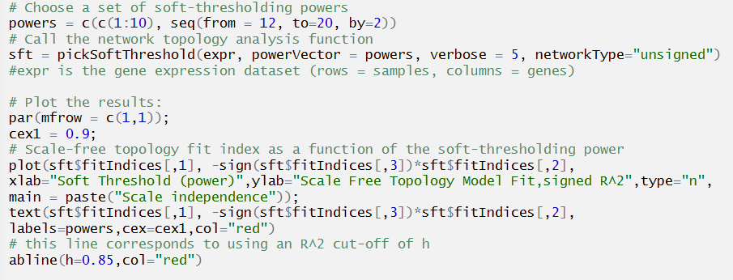
WGCNA Code
library(WGCNA)

Slide 34
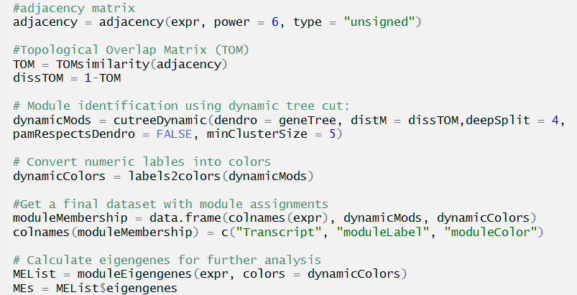
WGCNA Code Continued

Slide 35
Differential Co-expression
What modules are disrupted by a specific treatment or exposure?
R/Discordant
Looks at the edges and what edges change over the 2-groups
Perform WGCNA on posterior probabilities from discordant (Liz Litkowski)
R/DCGL: Differential Co-expression Analysis and Differential Regulation Analysis of Gene Expression Microarray Data

Slide 36
Prediction Modeling
Want to know best predictor for an outcome
What gene (or combination of genes) predicts disease the best?
Could just plug into an ordinary least squares (OLS) regression and perform backward selection
Major OLS concerns
Collinearity (expected in a biological system)
Using OLS, variance explodes with collinearity and makes your estimates unstable
Help reduce this inflated variance
Common Methods
Ridge Regression
LASSO
Random Forest

Slide 37
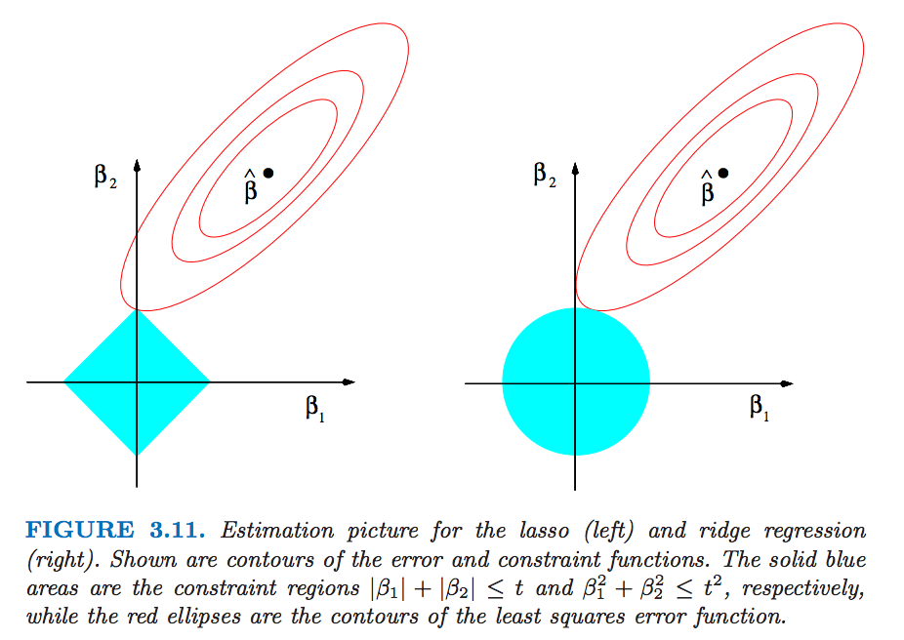
Overview of Ridge Regression & Lasso
LASSO (least absolute shrinkage and selection operator) regression
Reign in estimates by applying a penalty
Estimates need to be in the circle (ridge regression) or diamond (LASSO)
LASSO allows beta coefficients to be exactly 0 (feature selection)
Ridge: L2 penalty
LASSO: L1 penalty
https://bmcgenomics.biomedcentral.com/articles/10.1186/1471-2164-13-452
OLS: (Xβ−y)′(Xβ−y) Ridge: (Xβ−y)′(Xβ−y)+λ∥β∥₂
LASSO: (Xβ−y)′(Xβ−y)+λ∥β∥₁
Notes:
Blue lines are the contours of the RSS function around the OLS solution. The LASSO estimator is the point at which the innermost elliptical contour touches the diamond shaped LASSO penalty

Slide 38
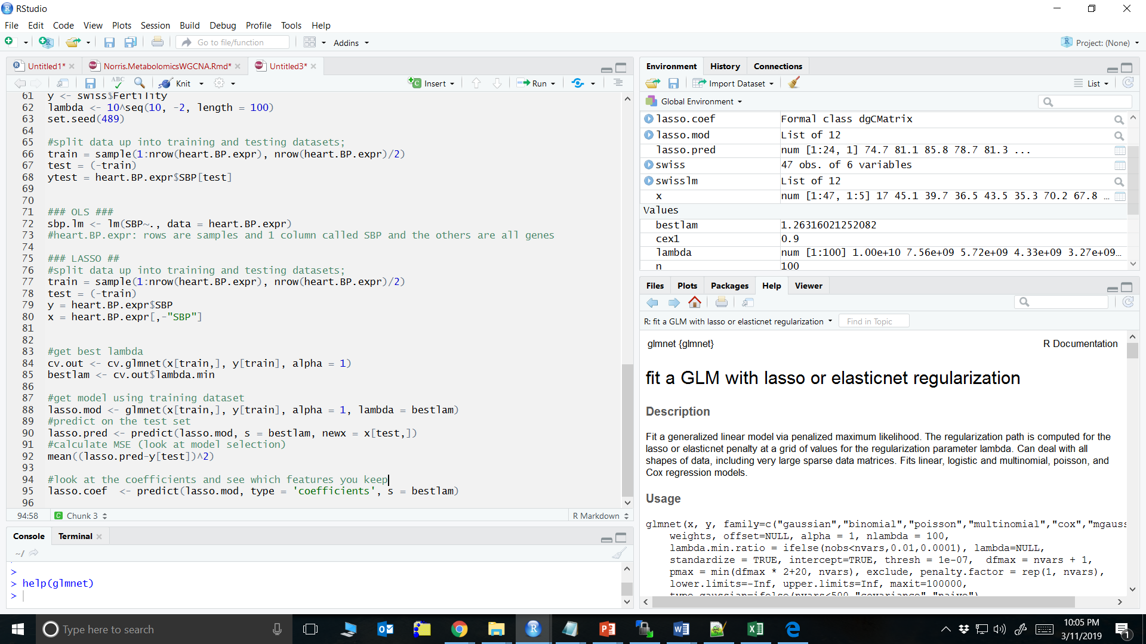
LASSO Code
library(glmnet)
alpha=0 is for ridge regression

Slide 39
LASSO Code
Normally plug the features you are keeping back into an OLS to get estimates now that you are selecting a subset of your features you won’t have the collinearity issues.

Slide 40
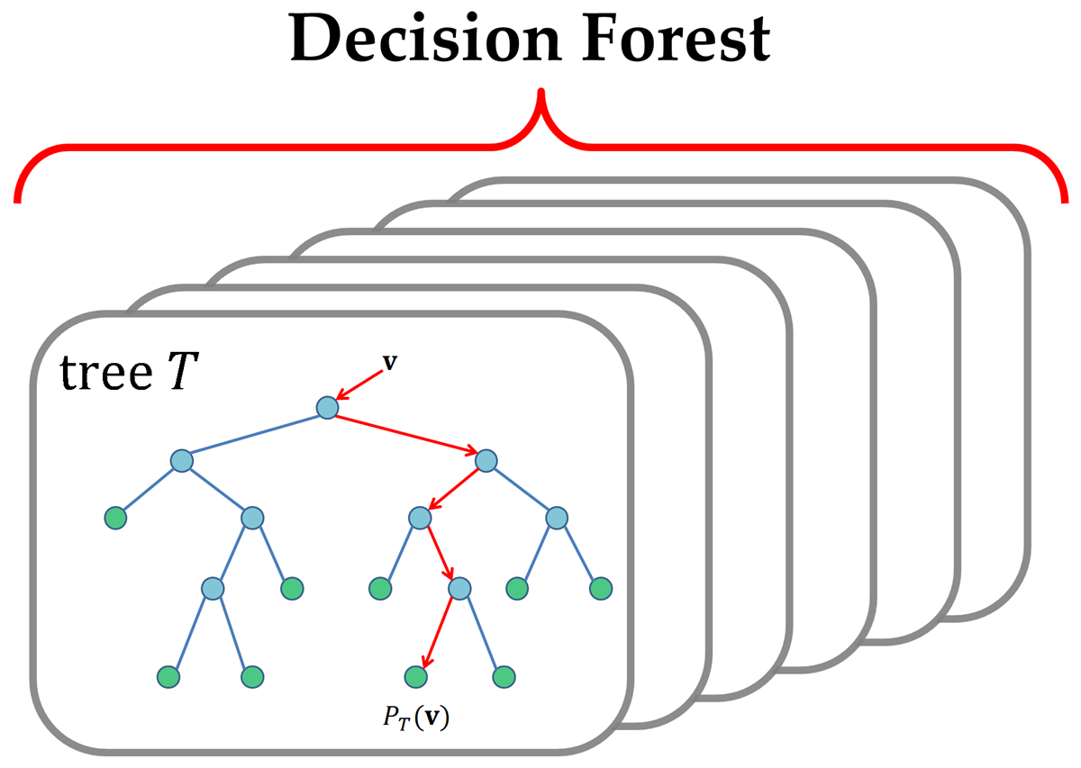
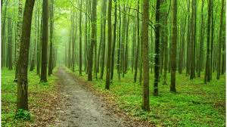
Random Forest
Just like a forest is made up of trees, random forest is made up may decision trees
Source: BBC
Source: dimensionless.in

Slide 41
Constructing a Single Tree
Random Sample Selection: Take 2/3 samples with replacement
Random Predictor Selection: Take sqrt(m) predictors
20K genes ~ 141 predictors for each tree
Start with which predictor separates out the best and move on down
What predictor explains the most variance?
Keep moving down the predictors till you get a formal tree
https://www.youtube.com/watch?v=LDRbO9a6XPU

Slide 42
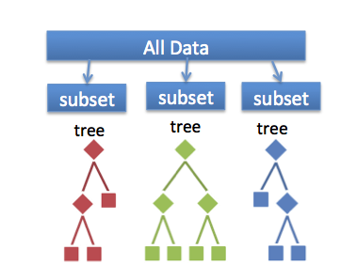
Random Forest
Collection of these decision trees
Avoid overfitting due to the “randomness” in each of your trees
Aggregate all the trees to get the importance of each predictor
Try to get a minimum amount of leaves (node with no children)
Like taking a poll of all the trees
R/randomforest
https://www.r-bloggers.com/how-to-implement-random-forests-in-r/
Source: towardsdatascience.com

